Slide 1
Week 2 GoToTraining

Slide 2
Topics
Contact Info
Things I saw in Project 1
Project 2
Benefits of JQMobile
Project 3 – What’s coming up?

Slide 3
Contact Information
Email: rgroffalarcon@fullsail.com
iChat: rgroffalarcon@aim.com
Text: 407-900-9648 – Please be sure to identify yourself.
Office Phone Number: 407-679-0100 x4151

Slide 4
What I saw in Project 1
FEATURE/SEARCH/BROWSE belongs on the index! You should NOT have a landing page.
Feature - Several were missing. Remember it contains:
an attractive image or logo.
should not take too much room.
a value proposition – short statement that tells the user the purpose of the app.

Slide 5
What I saw in Project 1
Search - Only 1 person needs to correct this. ☺
Browse – These should:
be categories that are on the form.
does not need to be dynamic; however, if you have the ability to code this, by all means do so!
should link to something; this is why I suggested the 404 error page.

Slide 6
What I saw in Project 1
Clear Entry Points – the only ones who didn’t have this were also missing the Feature.
Titled Sections – accomplished by:
implementing the Feature,
using a placeholder in the Search field
placing the words “Browse by”… above the Browse section.

Slide 7
What I saw in Project 1
List of Items – remember that each item MUST have a different name. Some of you only had 1 or 2; you WILL lose points EVERY week for not having this.
Problems with the CRUD:
A couple do not validate
A couple do not Save to Local Storage
EDIT

Slide 8
What I saw in Project 1
Failure to complete Project Video:
3% of grade is a 0
25% deduction to GPS
Project grade starts at 85

Slide 9
What I saw in Project 1
Failure to complete Discussion Video:
1% of grade is a 0
15% deduction to GPS
Failure to complete Discussion Responses:
1% of grade is a 0
10% deduction to GPS

Slide 10
What I saw in Project 1
If a person does not complete any videos or responses and submits a perfect grade (starts at 85) then he will have a 21%.
Project - 15% 85
Project Video - 3% 0
Discussion Video - 1% 0
Discussion Response - 1% 0

Slide 11
What I saw in Project 1
Not submitting:
Meaningful Commit – 20% deduction to GPS for EACH week
GTT proof of participation - 20% deduction to GPS for EACH week
Lynda.com screenshot - 20% deduction to GPS for EACH week
(HINT: as soon as you have completed the Lynda course, upload the certificate to all of the places where it is required. Every week and the actual assignment.)

Slide 12
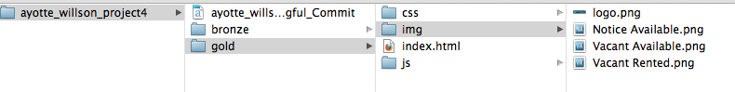
Things I saw in Project 1
Disorganization:
This will kill you when you begin working with 2 apps!
You may NOT share files between the apps!
It will also result in a point reduction.
HTML should never be in a folder.

Slide 13

Things I saw in Project 1
CONFUSION – Over thinking
Just justifying why you implemented a pattern the way you did. (ie. – Search field location).
GH-Pages links:
Not Merged with Master – this results in the file that I download and grade not being the file that you think you are submitting.
I wlll NOT ask for resubmissions this week forward.

Slide 14
Things I saw in Project 1
Git Branches:
Need to pull, commit, push and then merge
Need to commit, push and then merge
PERFECT!!!! ☺

Slide 15
Things I saw in Project 1
Git Resources:
http://www.lynda.com/Git-tutorials/Git-Essential-Training/100222-2.html
Scott Chacon - http://www.youtube.com/watch?v=ZDR433b0HJY
Scott Chacon - http://git-scm.com/book﻿
http://rogerdudler.github.com/git-guide/

Slide 16
More Things I saw in Project 1
Discussion Questions:
Your video is due Friday.
Your 2 responses are due Saturday.
Excellent discussion from those who participated!
Google Group … let’s talk about this.
IF this is the ONLY time you are late, I will NOT take points off of GPS.

Slide 17
Project 2

Slide 18
Project 2 - Rubric

Slide 19
Required
GOLD app
Eventually jQM only
Contains patterns that work BEST for your app.
BRONZE app
Contains the VFW CRUD
Search
Navigation
Item Details
One-Window Drilldown
List Inlay
Images
Thumbnail & Text
Thumbnail Grid
Order (Newsstream)

Slide 20
“BRONZE App”
What is it?
It is a fully functioning app in which you implement pattern choices that may not be optimal.
“BRONZE APP” has nothing to do with broken code.
Do I have to create a new app?
NO

Slide 21
jQuery Mobile (JQM)

Slide 22
Benefits
Provides increased functionality.
Makes app aesthetically pleasing.
Navbars are easy to implement.
Styled Buttons
Icons on buttons
Search will easily work and is required this week for the home page.

Slide 23
Project 2 Requirements
Search – MUST function this week:
In jQM it is not a search, it is a filter.
It is not dynamic.
data-filter=“true”
It will need to be on each page that the user will search.

Slide 24
Project 2 Requirements
Navigation:
Prevents the user from being “stuck” in the app.
Should be on every page, except the VFW CRUD form and the Display Data.
Must include a link to Home, an Info page or About page, Newsstream (or any other page that you think is appropriate, some put an additem link here).

Slide 25
Project 2 Requirements
Navigation: Info or About Page
Should contain links to Git.
Should contain links to both the Gold and the Bronze app.
Should include a link to Home.
May include information about yourself or credit for images or assistance (if in doubt, give credit).

Slide 26
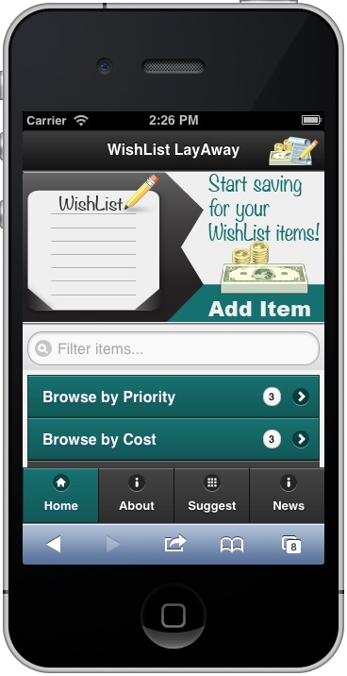
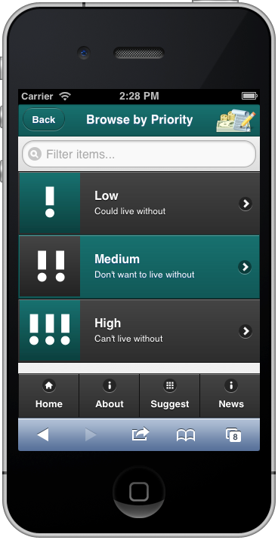
Navbar
Include:
HOME
ABOUT or INFO
NEWSSTREAM
Any other page that you feel would be appropriate.
Additem
Suggestions
etc

Slide 27
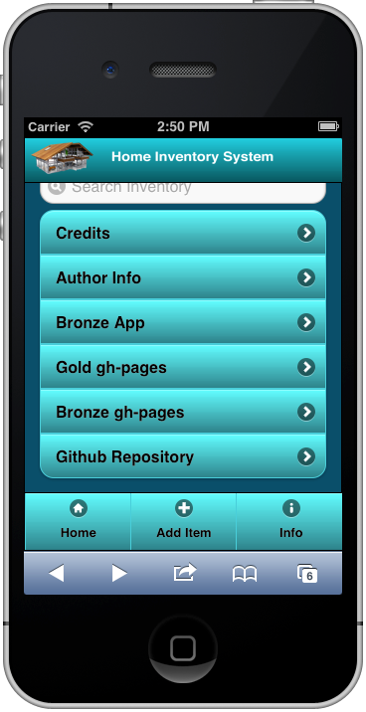
Example of ABOUT of INFO Page
REQUIRED:
Links to each app
Links to the Repo
Links to the Live Pages
Credits – if needed.

Slide 28
Project 2 Requirements
Item Details - at least one must be in each app; however, each must be used:
One Window Drilldown (pgs 202 – 205)
A list of items in a single window.
List Inlay (pgs 206 – 209)
JQM collapsible sets.
Infinite List (pgs 462 – 464) – Not required

Slide 29
One-Window Drilldown

Slide 30
List Inlay

Slide 31
Infinite List – NOT required

Slide 32
Project 2 Requirements
Images – each MUST be used. GOLD app and your BRONZE app MUST contain at least one!
Thumbnail Grid (pgs 210 – 215)
JQM layout grid
Thumbnail and Text List (pgs 459 – 461)
Thumbnail

Slide 33
Thumbnail Grid

Slide 34
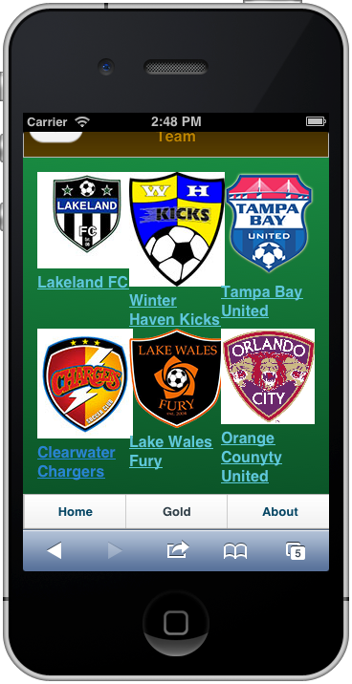
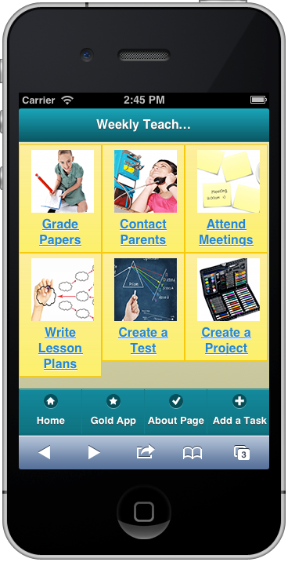
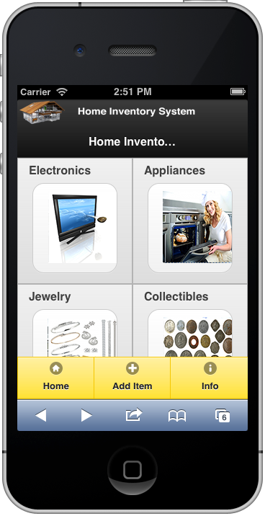
Thumbnail Grid

Slide 35
Thumbnail and Text List

Slide 36
Project 2 Requirements
Order – only required in one app.
News Stream (pgs 34 – 39) – This is the ONLY thing that may be hardcoded into your app. This is NOT a link to CNN, etc. Newest item is on top.
If your app is a calendar app or a reminder app, then what is coming due first would be on top.

Slide 37

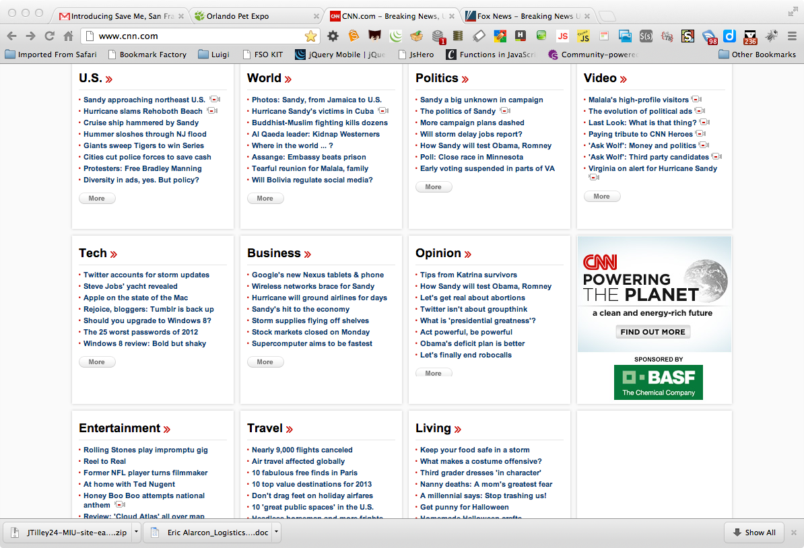
News Stream
News stations
Email
Facebook

Slide 38
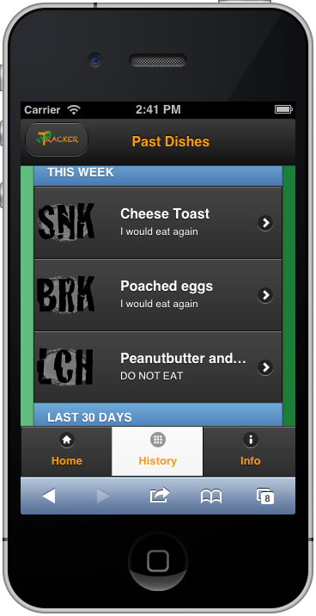
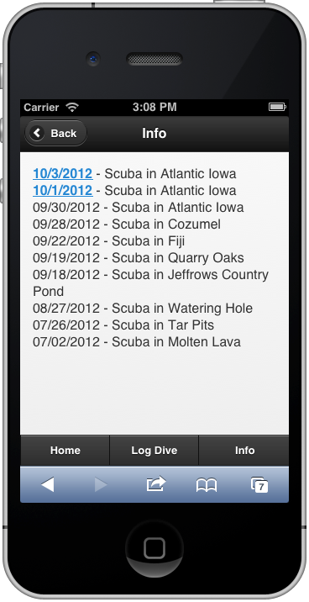
News Stream
The Latest entry belongs on top the ONLY exception is if the app is a calendar app and then the item that is upcoming first should be on top.

Slide 39
DO NOT ADD JQM to:
addItem.html
NEVER in the BRONZE app
Not in the GOLD app until next week – UNLESS you plan to implement the new main.js and refactor your js
JSON Display page
NEVER in the BRONZE app
Not in the GOLD app – UNLESS you plan to implement the new main.js and refactor your js

Slide 40
Lessons Learned
It uses AJAX to perform many of it’s functions.
It does not perform a true page change, it lays one page over the other. For this reason, all external pages will appear to “break”.
In order to correct this external page calls must have:
data-ajax=“false” – preferred as it handles all of the AJAX hijacking
OR
rel=“external” – only handles page changes

Slide 41
Deliverables

Slide 42
Project 2 - Rubric

Slide 43
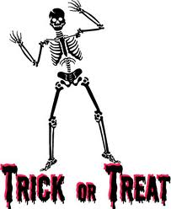
Deliverables
Two fully functioning apps:
Your “GOLD medal” app. – JQM
This is the app in which you apply interface and usability patterns that you like and think work well in your app.
Your “BRONZE medal” app. – Your choice
This is the app in which you apply interface and usability patterns that you don’t think work as well in your app.
Both Apps MUST contain a fully, functioning CRUD!

Slide 44
Deliverables (cont.)
File Naming
Clickable Files

Slide 45
What’s coming up? Project 3

Slide 46
What’s coming up? Project 3
FORMS
Selection Items
Hints
Input Prompts
Dropdown Chooser Patterns
Good Defaults
Range slider
Date-field
Checkboxes
Prominent Done Buttons
Same-Page Error Messages

Slide 47
Do we see anything wrong with this?

Slide 48
Is something wrong here?
<script type="text/javascript" src="js/json.js"></script>
<script type="text/javascript" src="js/main.js"></script>
<script type="text/javascript">
function showValue(newValue,range)
{
document.getElementById(range).innerHTML=newValue;
}
</script>
==========================================================
<script src="JS/json.js" type="text/javascript"></script>
<script src="JS/main.js" type="text/javascript"></script>
<script type="text/javascript">
function showValue(newValue,range)
{
document.getElementById(range).innerHTML=newValue;
}
</script>
==========================================================

Slide 49
Is something wrong here?
<script src="js/main.js" type="text/javascript"></script>
<script src= "js/JSON.js" type= "text/javascript"></script>
<script type="text/javascript">
function showValue(newValue,range)
{document.getElementById(range).innerHTML=newValue;}
function showValue(newValue2,range)
{document.getElementById(range).innerHTML=newValue2; }
</script>

Slide 50
Is something wrong here?
<p><input id="submit" name="submit" type="button" value="Submit Medication"></p>
</form>
<script type="text/javascript">
function showValue(newValue, daily){
document.getElementById(daily).innerHTML=newValue;}
</script>
=========================================================
<!-- Required JavaScript -->
<script type="text/javascript" src="js/main.js"></script>
<script type="text/javascript" src="js/json.js"></script>
<script type="text/javascript">
function setbg(color) {
document.getElementById("rComments").style.background=color}
</script>

Slide 51
Is something wrong here?
<!--update the input field that shows the slider value with the current slider value-->
<script type="text/javascript">
function updateTextInput(val) {
document.getElementById('textInput').value=val;}
</script>
==========================================================
<a href="#" id=aboutButton>About</a>
<script>
$("#aboutButton").click(function () {
$("#about").slideToggle("slow");});
</script>
==========================================================

Slide 52
Is something wrong here?
<script src="js/json.js" type="text/javascript"></script>
<script src="js/main.js" type="text/javascript"></script>
<script type="text/javascript">
var datefield=document.createElement("input")
datefield.setAttribute("type", "date")
if (datefield.type!="date"){ //if browser doesn't support input type="date", load files for jQuery UI Date Picker
document.write('<link href="http://code.jquery.com/ui/1.9.0/themes/base/jquery-ui.css" rel="stylesheet" type="text/css" />\n')
document.write('<script src="http://ajax.googleapis.com/ajax/libs/jquery/1.4/jquery.min.js"><\/script>\n')
document.write('<script src="http://ajax.googleapis.com/ajax/libs/jqueryui/1.8/jquery-ui.min.js"><\/script>\n’)}
</script>

Slide 53
Mini Assignment
Send an email to me that explains the difference between HELPING someone debug and CHEATING.

Slide 54
Happy Coding!

